Slide 1
Learn Why use Selenium with 3 Million Dollar Bugs ?

Slide 2
Agenda
What Is A Million Dollar Bug?
Million Dollar Bug #1
Million Dollar Bug #2
Million Dollar Bug #3
Impact Of A Million Dollar Bug
Best Practices to Avoid Such Bugs
How Selenium Automation Helps

Slide 3
What Is A Million Dollar Bug??

Slide 4
What Is A Million Dollar Bug??
A bug that took a million dollar to get detected
A bug that costed a million dollar damage in business
A bug that has caused a damage to company’s reputation
A bug which has been reported by a customer

Slide 5
Million Dollar Bug #1

Slide 6

Bug #1 : Immigration
The system was incapable of dealing with backlog cases.
Resulted in 29000 applications backlog.
Also failed to locate 50000 people
Cost up to $1.6 billion

Slide 7
Million Dollar Bug #2

Slide 8
Bug #2 : Automobile
Software glitch that can potentially shutdown the hybrid system while on the road
Worldwide recall for 1.9 million hybrid prius cars
130,000 hybrid prius cars in europe
713,000 in north America
997,000 in japan
Toyota has recalled over 1.9 million hybrid Prius cars due to a software glitch
Cost more than $2 billion

Slide 9
Million Dollar Bug #2

Slide 10
Bug #3 : E-Commerce
Cost up to $100,000

Slide 11
How Do These Bugs Creep In

Slide 12
Impacts

Slide 13
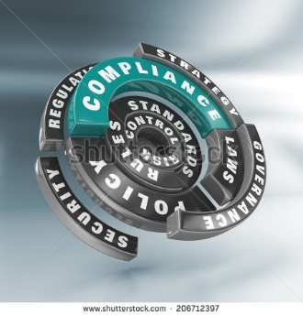
Best Practices to Avoid Bugs

Slide 14

Best Practices to Avoid Bugs

Slide 15
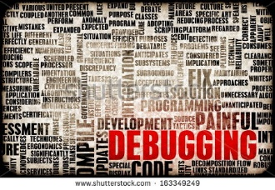
Best Practices to Avoid Bugs

Slide 16

Best Practices to Avoid Bugs

Slide 17

Best Practices to Avoid Bugs

Slide 18

Best Practices to Avoid Bugs
Testing

Slide 19

Best Practices to Avoid Bugs
Testing

Slide 20

Best Practices to Avoid Bugs
Testing

Slide 21
Why Rigorous Testing is Mandatory

Slide 22
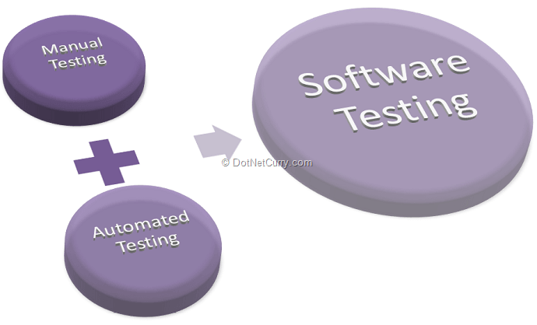
Ways of Software Testing

Slide 23
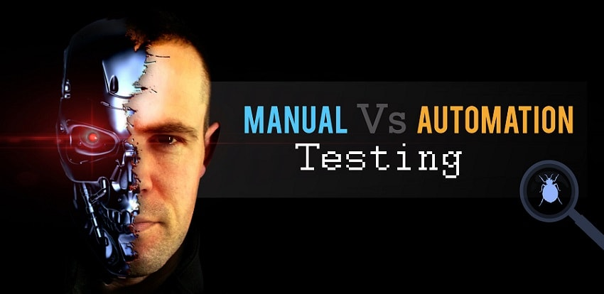
Manual Vs Automation

Slide 24
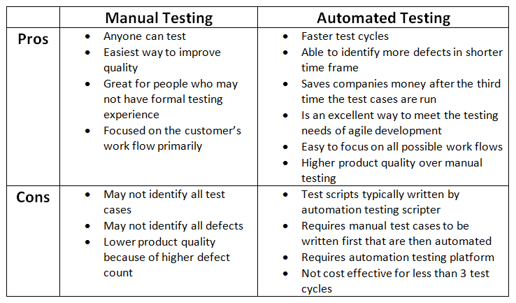
Manual Vs Automation

Slide 25
Which Test Cases To Automate And Which To Not?
Test cases to be automated can be selected using the following criterion :
The following category of test cases are not suitable for automation :

Slide 26
Selenium salient features

Slide 27
Selenium WebDriver salient features

Slide 28
Can We Avoid Bugs Completely??
Can we Eliminate every chances Million Dollar Bugs by following best practices ??
No one's perfect, and no matter what we do, we are going to produce code that has bugs in it from time to time

Slide 30
Notes:
<number>

Slide 31
Survey
Notes:
<number>

